Slide 1
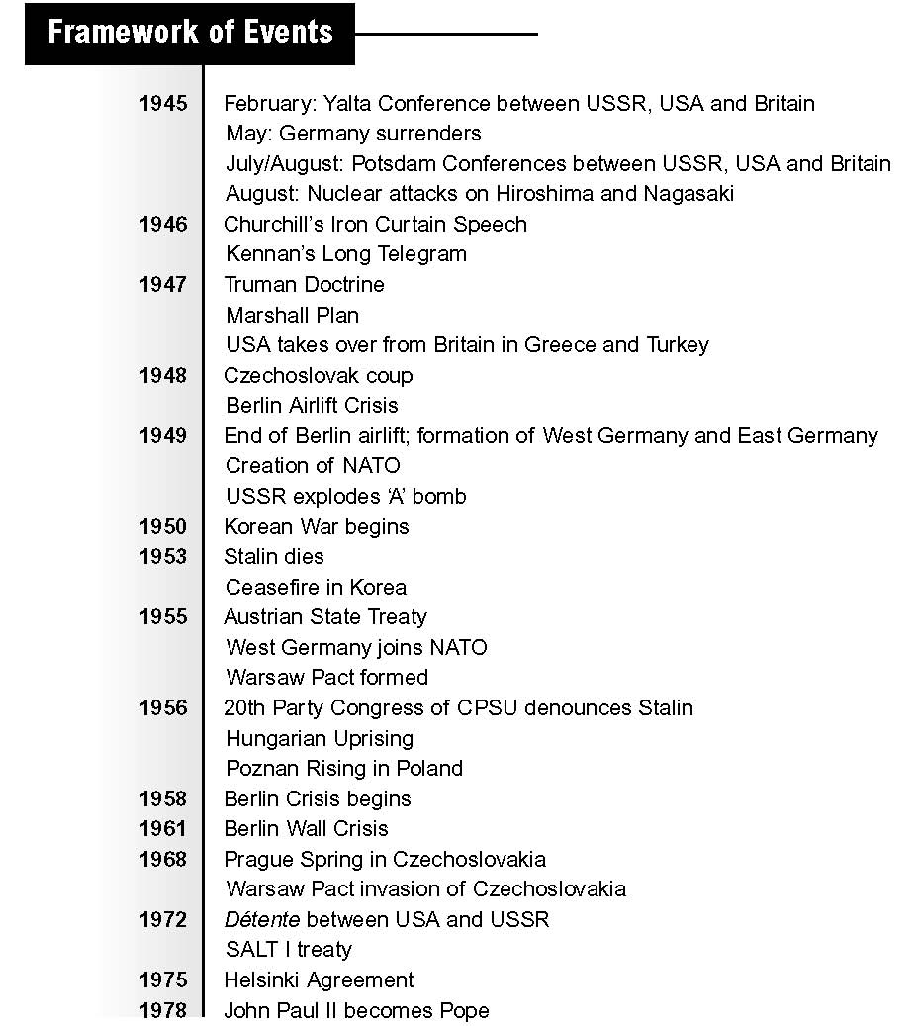

Slide 2
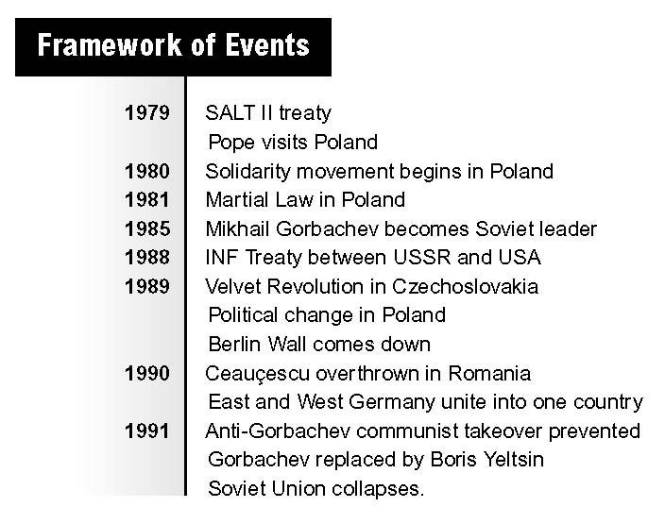

Slide 3
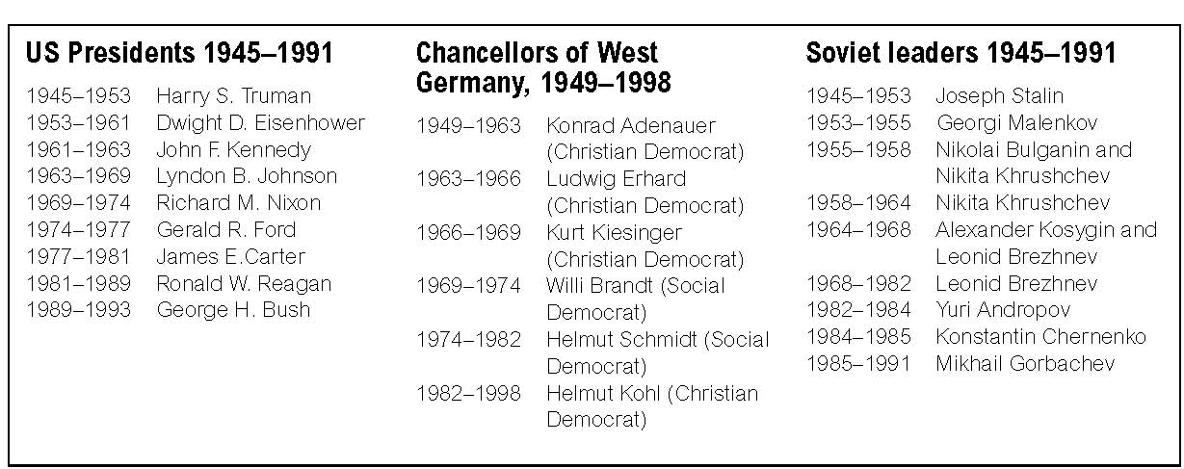

Slide 4
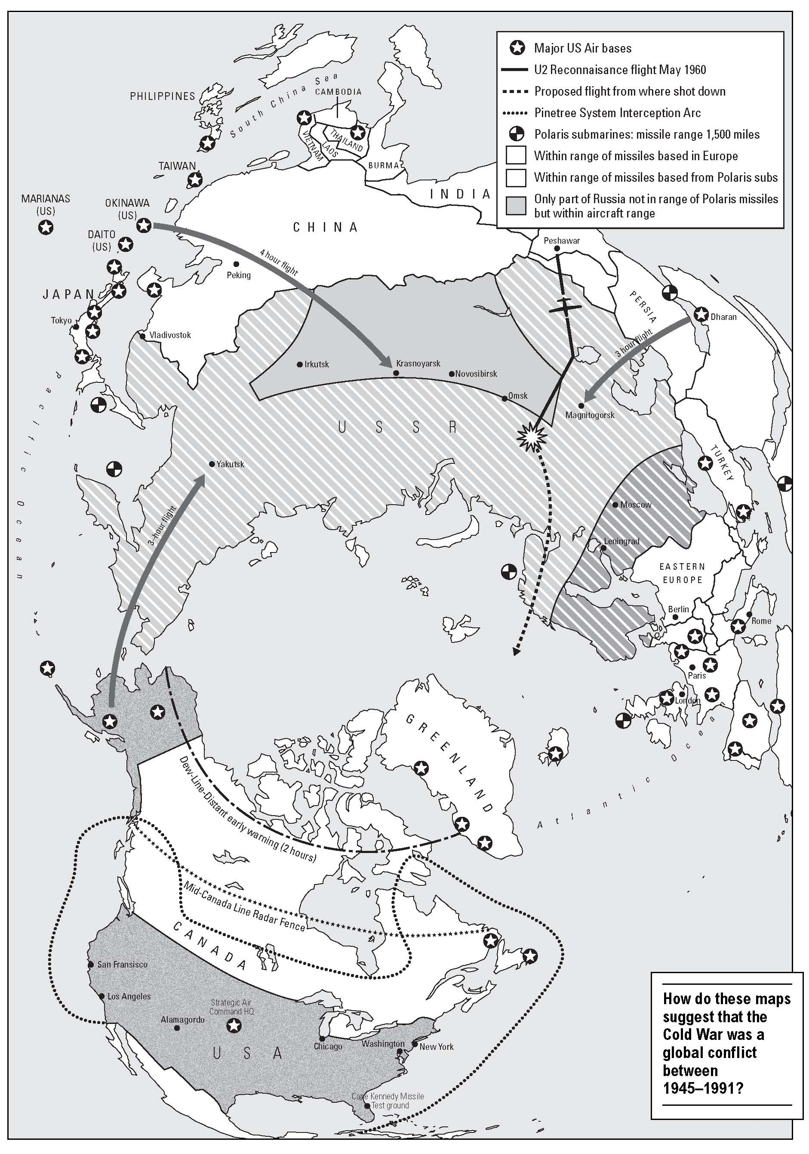
Notes:
American preparedness in 1960.

Slide 5
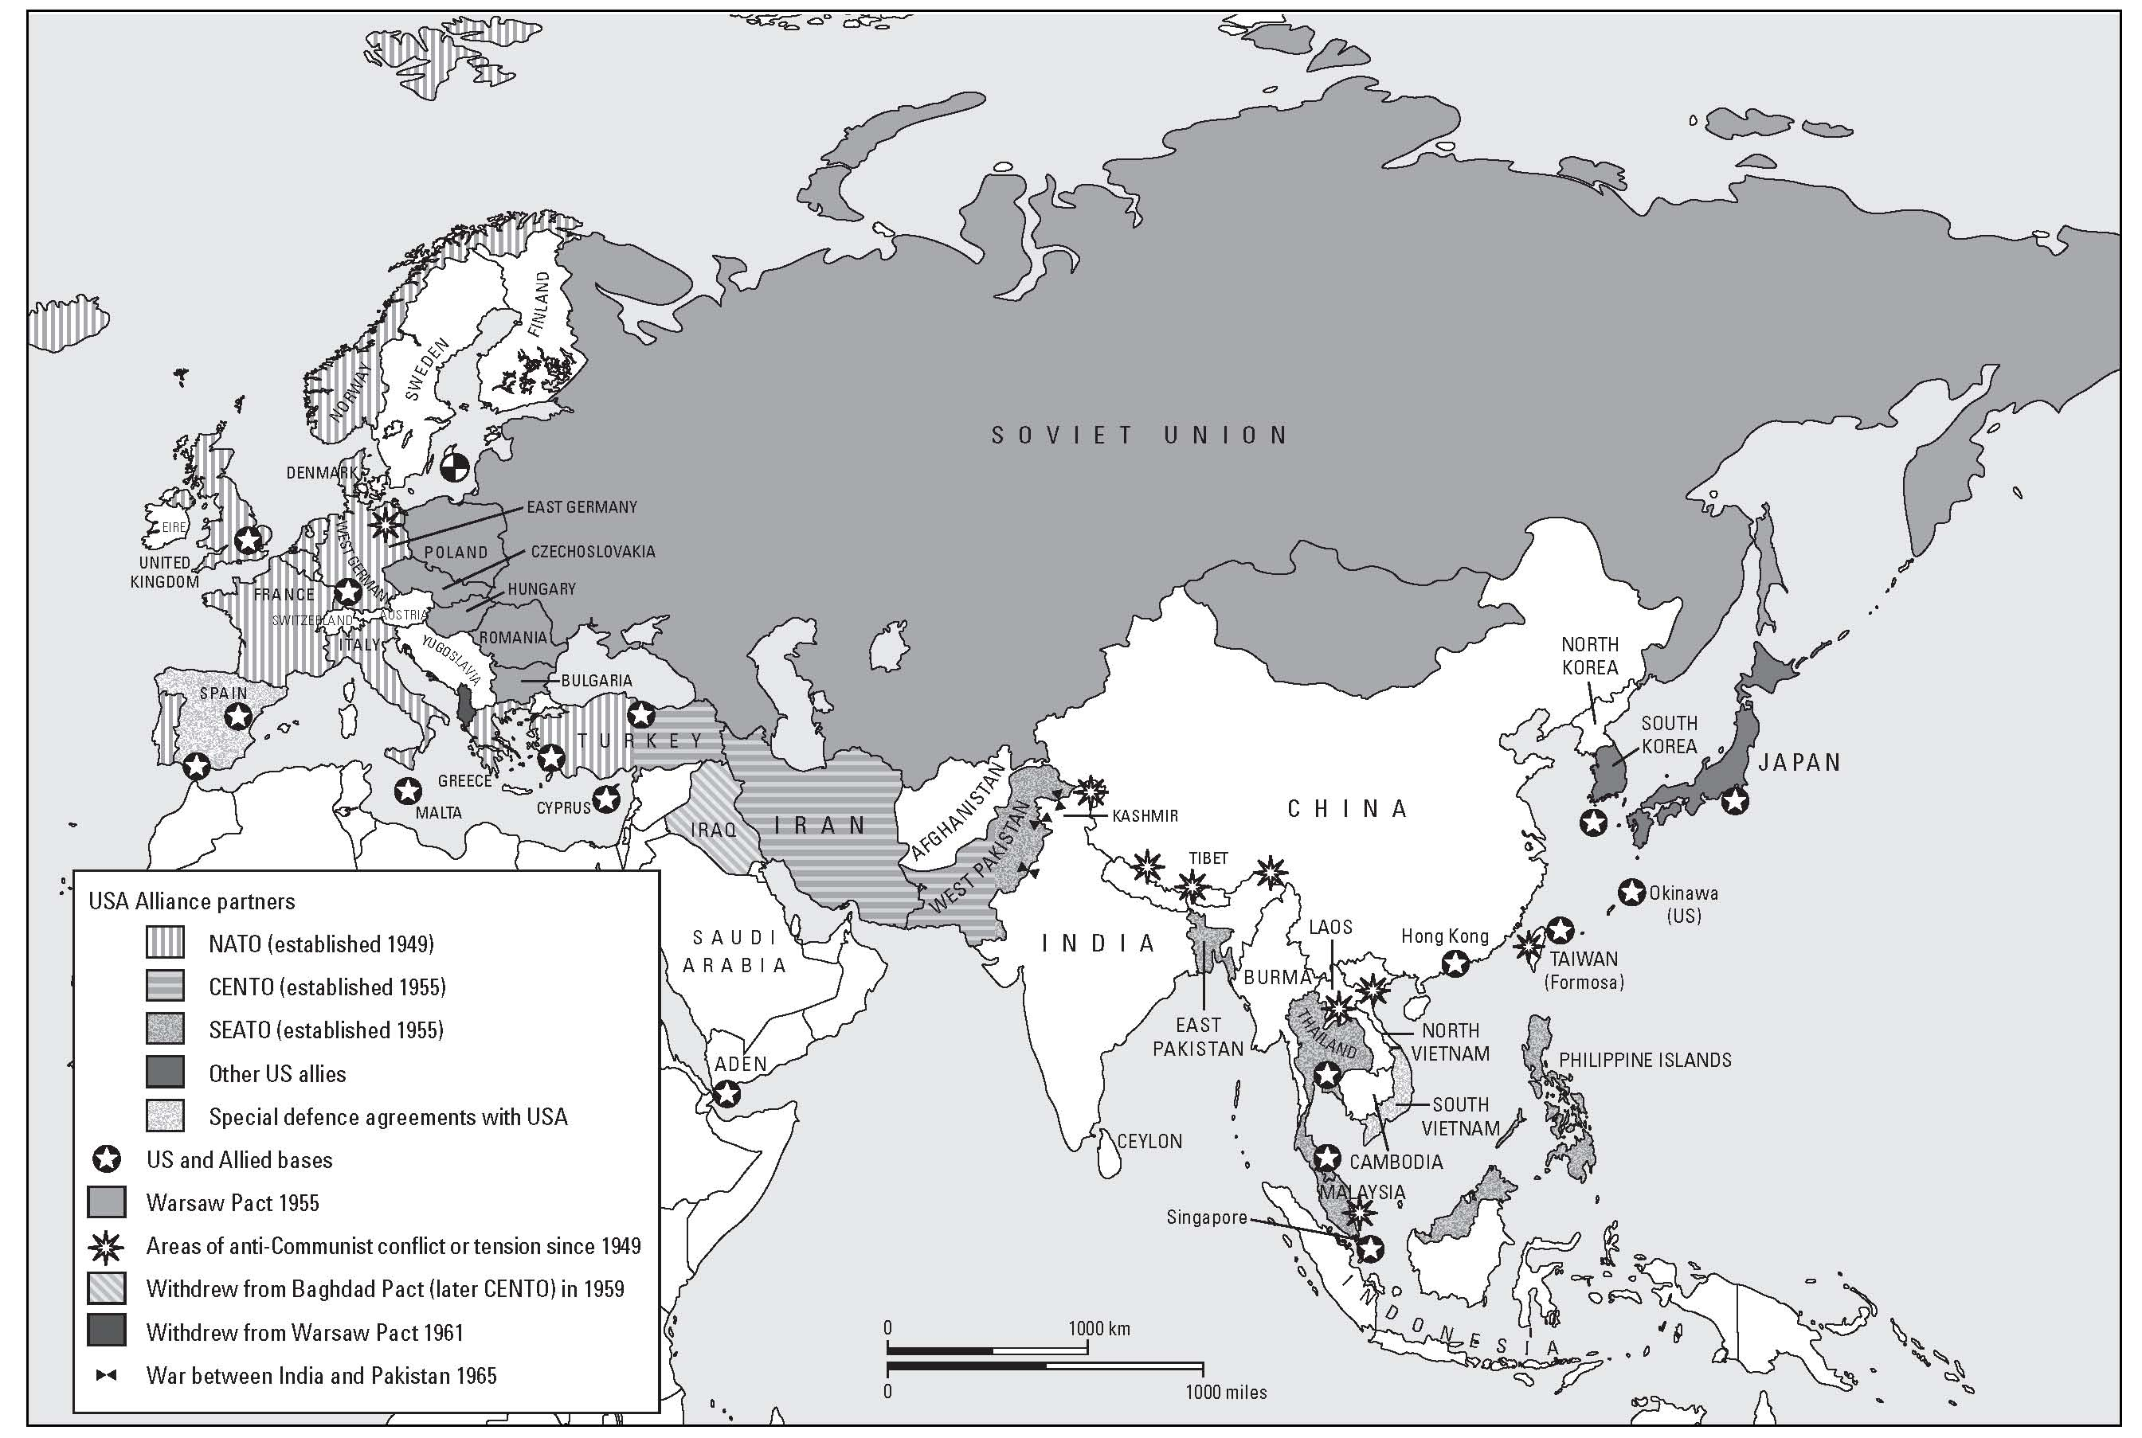
Notes:
European and Asian alliances 1949–1965.

Slide 6
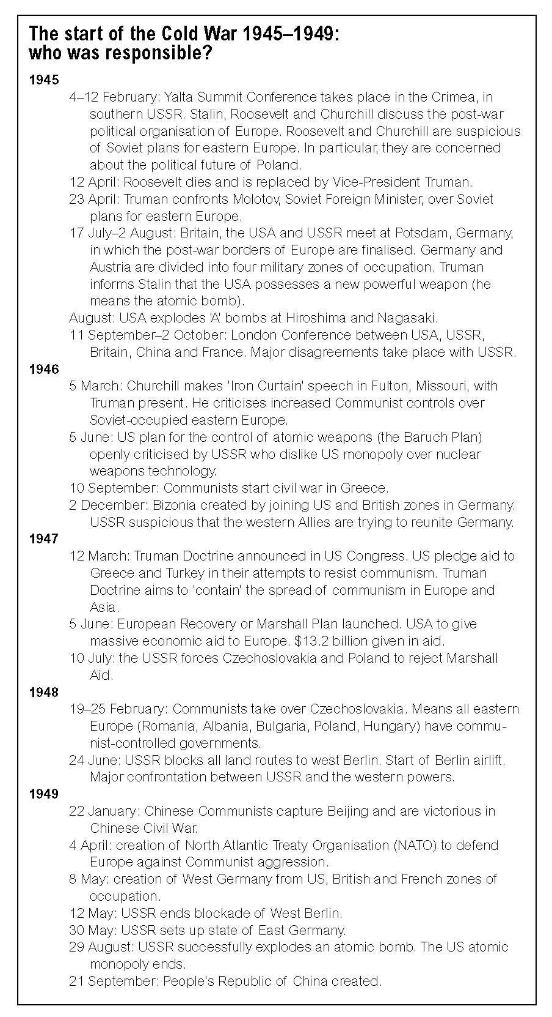

Slide 7
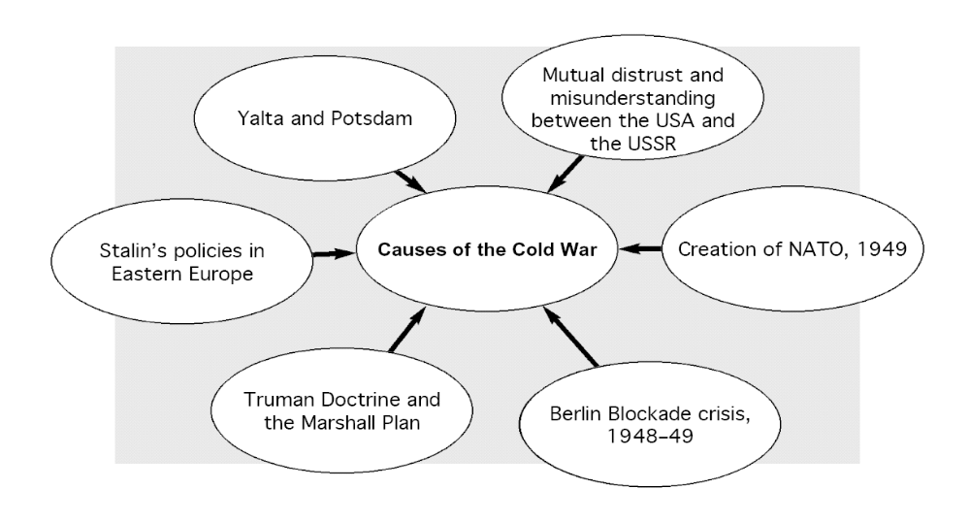

Slide 8
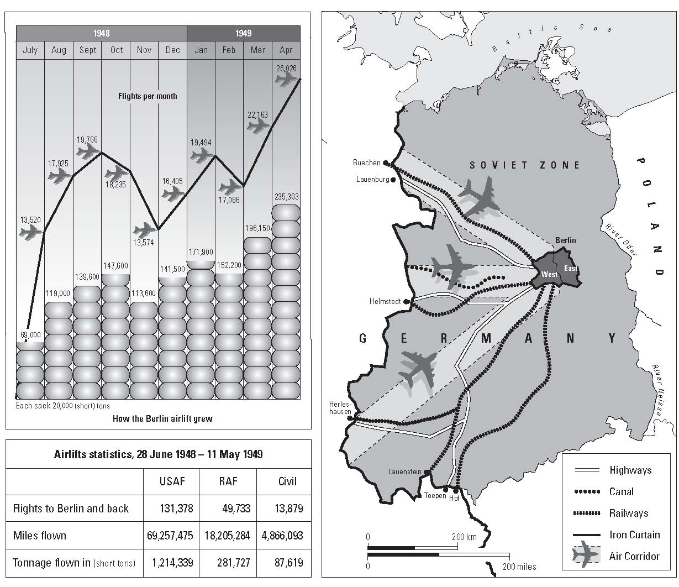
Notes:
The Berlin Airlift.

Slide 9
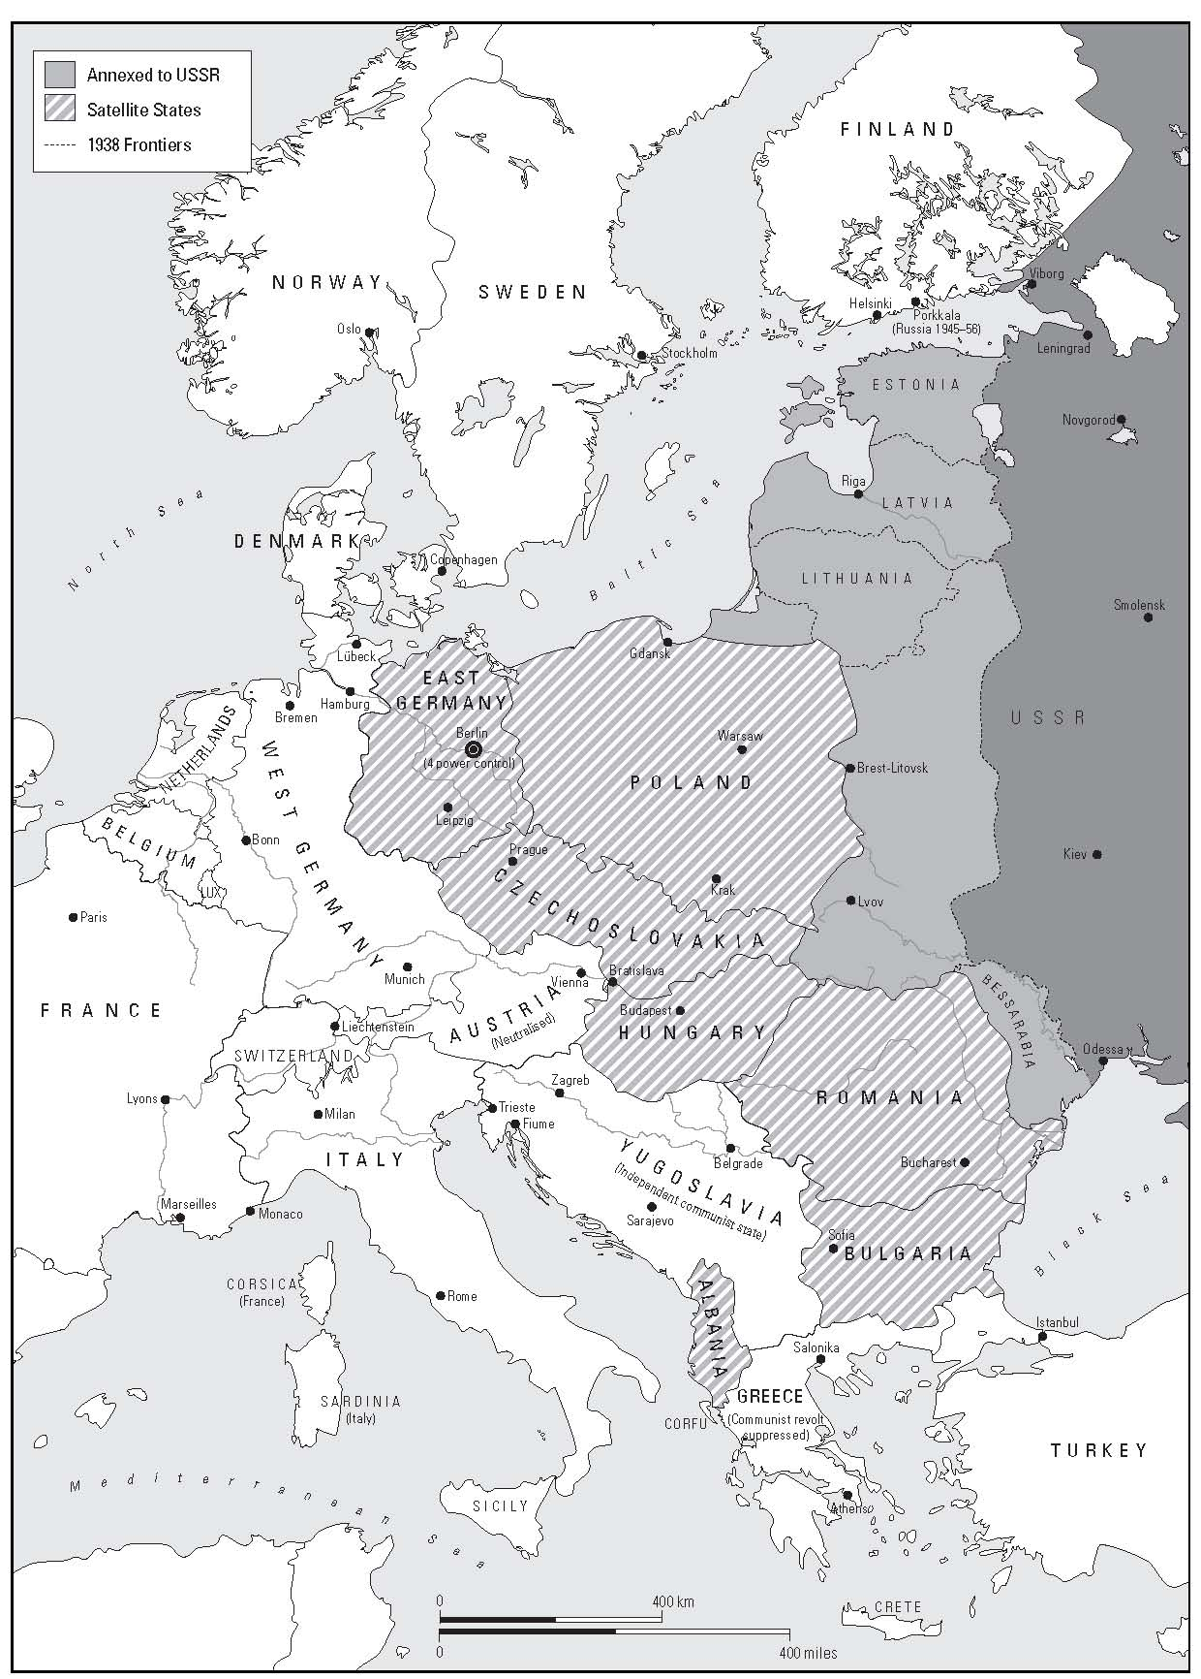
Notes:
Central Europe 1955.

Slide 10
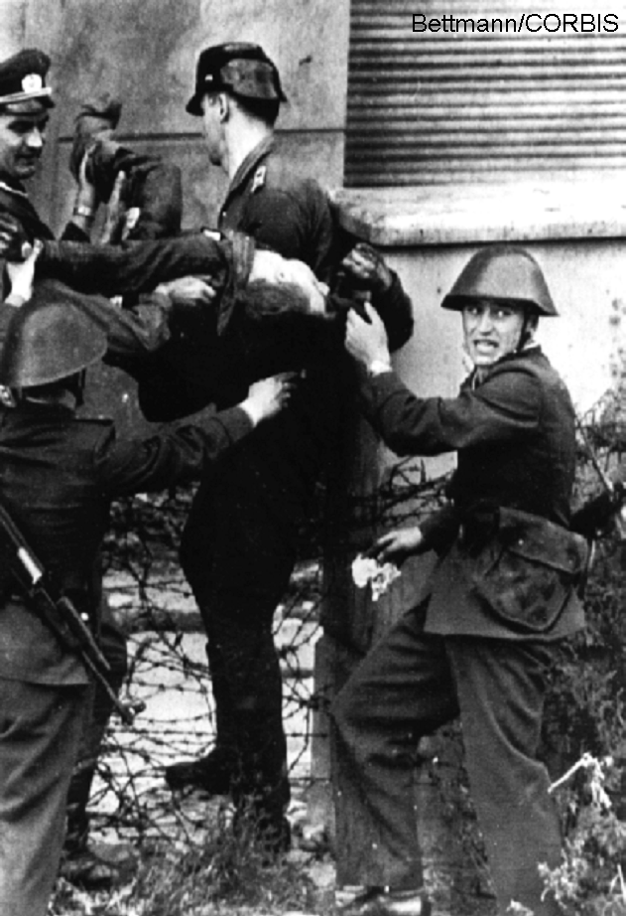
Notes:
Berlin Wall, 7 September 1962. East German policemen lift the body of Peter Fechter, who was shot down while trying to escape to the West.

Slide 11
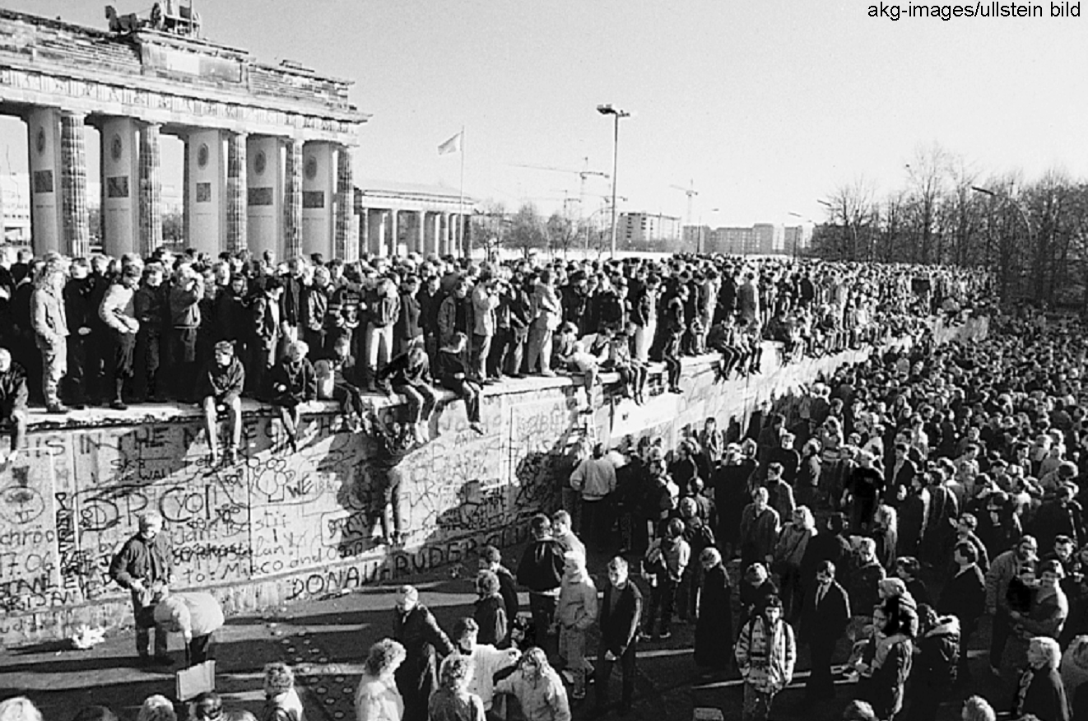
Notes:
Celebrations at the Berlin Wall after unification, 1989.

Slide 12
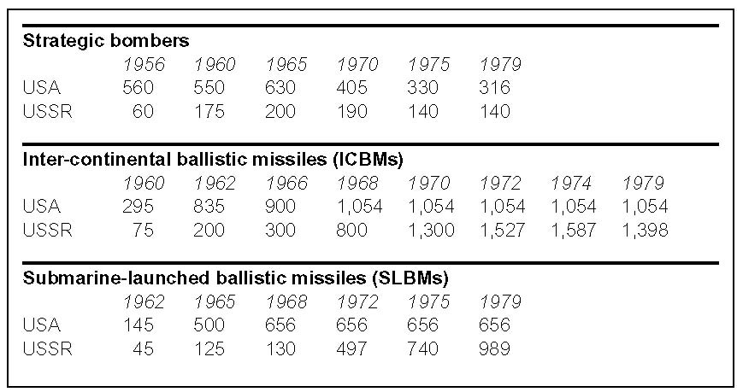

Slide 13
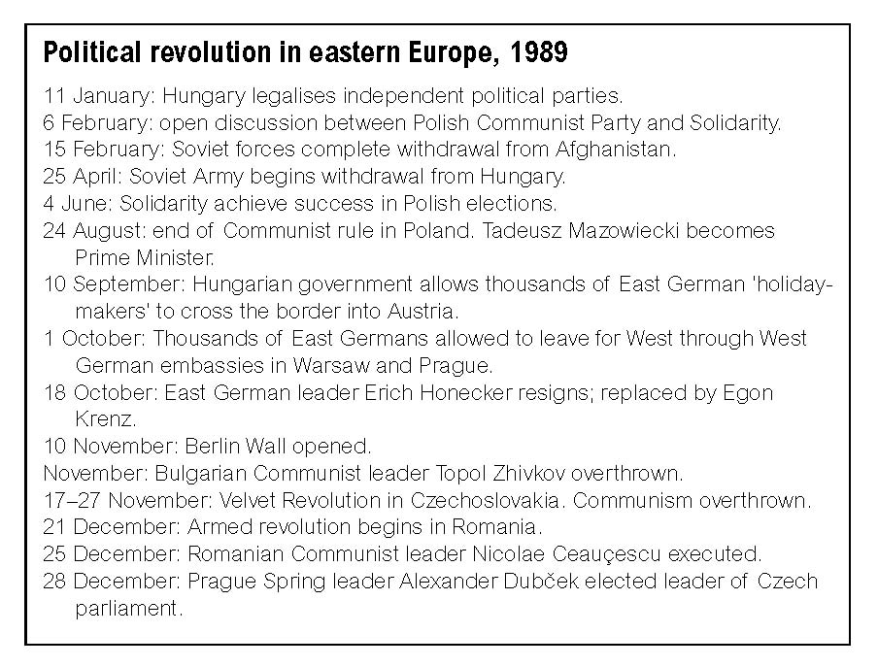

Slide 14
